Slide 1
blinkit
India's Last Minute App
Sales Performance
& Analytics Report
Comprehensive Analysis of Sales · Customer Satisfaction · Inventory Distribution
Developed by
👤 Ajay Yadla

Slide 2
BUSINESS REQUIREMENT
Project objective, KPI requirements, Granular & Chart specifications
📋 PROJECT OBJECTIVE
🔍 GRANULAR REQUIREMENTS
📈 CHART'S REQUIREMENTS
To conduct a comprehensive analysis of Blinkit's sales performance, customer satisfaction, and inventory distribution to identify key insights and opportunities for optimization using KPIs and visualizations in Power BI.
1
Total Sales by Fat Content:
% Sales by Outlet Size:
5
Analyze impact of fat content on total sales + KPIs
Analyze correlation between outlet size and total sales
📊 KPI'S REQUIREMENTS
2
Total Sales by Item Type:
Performance of item types in terms of total sales + KPIs
6
Sales by Outlet Location:
1
Total Sales:
Overall revenue from all items sold
Assess geographic distribution of sales across locations
2
Average Sales:
3
Fat Content by Outlet for Total Sales:
Average revenue per sale
Compare total sales across outlets by fat content
3
Number of Items:
7
All Metrics by Outlet Type:
Total count of items sold
Total Sales by Outlet Establishment:
Total Sales, Avg Sales, No. of Items, Avg Rating by outlet type
4
Average Rating:
4
Average customer rating for items
How age of outlet establishment influences total sales

Slide 3
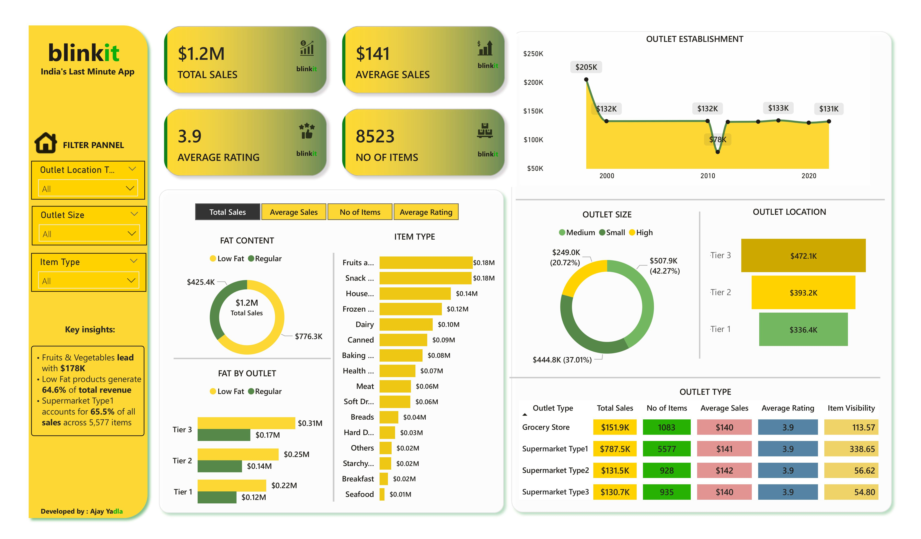
KPI'S REQUIREMENTS
4 Key Performance Indicators — Foundation of the Blinkit Sales Analysis
1
💰
$1.20M
2
📊
$141
TOTAL SALES
AVERAGE SALES
The overall revenue generated from all items sold across all outlets, categories, and locations.
The average revenue earned per individual sale transaction across the entire dataset.
3
📦
8,523
4
⭐
3.97★
NUMBER OF ITEMS
AVERAGE RATING
The total count of different items sold — representing the breadth of product reach across all outlets.
The average customer satisfaction rating for items sold, measured on a 5-star scale.
💡 These 4 KPIs measure revenue, efficiency, product reach, and customer satisfaction — driving every chart in this report

Slide 4

1 · TOTAL SALES BY FAT CONTENT
Analyzing the impact of fat content on total sales and additional KPI metrics
🎯 OBJECTIVE
💡 KEY INSIGHT
Analyze the impact of fat content (Low Fat vs Regular) on total sales, and assess how Average Sales, Number of Items, and Average Rating vary with fat content.
Low Fat products drive 64.6% of revenue ($776K), confirming strong health-conscious consumer preference consistently across all outlet types and locations.
Low Fat Sales:
$776K
64.6%
Regular Sales:
$425K
35.4%
Low Fat Items:
5,517
items
Regular Items:
3,006
items
blinkit · Chart 1: TOTAL SALES BY FAT CONTENT · March 2026

Slide 5
2 · TOTAL SALES BY ITEM TYPE
Identifying the performance of different item types in terms of total sales
Identify the performance of different item types in terms of total sales, and assess how Average Sales, Number of Items, and Average Rating vary across item types.
🎯 OBJECTIVE
💡 KEY INSIGHT
Fruits & Vegetables lead with $178K (14.8%), closely followed by Snack Foods at $175K (14.6%). Top 3 categories alone contribute 40.7% of total revenue.
#1 Fruits & Veg:
$178K
14.8%
#2 Snack Foods:
$175K
14.6%
#3 Household:
$136K
11.3%
Top 3 Combined:
$489K
40.7%
blinkit · Chart 2: TOTAL SALES BY ITEM TYPE · March 2026

Slide 6
3 · FAT CONTENT BY OUTLET FOR TOTAL SALES
Comparing total sales across different outlets segmented by fat content
🎯 OBJECTIVE
💡 KEY INSIGHT
Compare total sales across outlets segmented by fat content. Assess how KPIs (Avg Sales, No. of Items, Avg Rating) vary with fat content across each outlet location tier.
Tier 3 outlets show the highest Low Fat sales at $0.31M. Across all tiers, Low Fat consistently outperforms Regular — confirming a universal consumer health preference.
Tier 3 – Low Fat:
$0.31M
highest
Tier 2 – Low Fat:
$0.25M
mid
Tier 1 – Low Fat:
$0.22M
lowest
Trend:
All Tiers
Low Fat leads
blinkit · Chart 3: FAT CONTENT BY OUTLET FOR TOTAL SALES · March 2026

Slide 7
4 · TOTAL SALES BY OUTLET ESTABLISHMENT
Evaluating how the age of outlet establishment influences total sales
🎯 OBJECTIVE
💡 KEY INSIGHT
Evaluate how the year of outlet establishment influences total sales performance, identifying which establishment eras generate the most revenue.
Outlets established in 1998 generate the highest revenue at $205K — 57% above average. Mature stores benefit from decades of loyalty, optimized operations & prime locations.
Peak Year:
1998
$205K
Lowest Year:
2011
$78K
Recent (2022):
$131K
stable
Maturity Premium:
+57%
vs avg
blinkit · Chart 4: TOTAL SALES BY OUTLET ESTABLISHMENT · March 2026

Slide 8
5 · PERCENTAGE OF SALES BY OUTLET SIZE
Analyzing the correlation between outlet size and total sales contribution
🎯 OBJECTIVE
💡 KEY INSIGHT
Analyze the correlation between outlet size (Small, Medium, Large) and total sales to identify which outlet size contributes the most to overall revenue.
Medium outlets dominate with 42.3% of total sales ($508K), followed by Small at 37.0% ($445K). Medium-sized stores are the sweet spot — highest return for Blinkit.
Medium Outlets:
$508K
42.3%
Small Outlets:
$445K
37.0%
Large Outlets:
$249K
20.7%
Best Performer:
Medium
optimal

Slide 9
6 · SALES BY OUTLET LOCATION
Assessing geographic distribution of sales across different location tiers
🎯 OBJECTIVE
💡 KEY INSIGHT
Assess the geographic distribution of total sales across outlet location tiers (Tier 1, Tier 2, Tier 3) to identify which regions drive the most revenue.
Tier 3 cities lead at $472K (39.3%), outperforming metro Tier 1 cities ($336K, 28%). Smaller markets show massive untapped demand — priority expansion opportunity.
Tier 3 Cities:
$472K
39.3%
Tier 2 Cities:
$393K
32.7%
Tier 1 Cities:
$336K
28.0%
Tier 3 Leads:
#1
of 3

Slide 10
7 · ALL METRICS BY OUTLET TYPE
Total Sales · Average Sales · Number of Items · Average Rating by outlet type
🎯 OBJECTIVE
💡 KEY INSIGHT
Provide a comprehensive view of all key metrics (Total Sales, Average Sales, Number of Items, Average Rating) broken down by each different outlet type.
Supermarket Type1 dominates with $787.5K and 5,577 items (65.5% share). Grocery Stores achieve the highest customer rating at 3.99★ despite lower sales volume.

Slide 11
POWER BI DASHBOARD
blinkit · Power BI Sales Dashboard · All data from BlinkIT Grocery Dataset

Slide 12
STRATEGIC RECOMMENDATIONS
HIGH
🥗 Expand Low Fat Portfolio
HIGH
🏙️ Tier 3 City Expansion
Grow Low Fat range by 20–30% to capture 64.6% health-conscious demand
Open 10–15 new outlets in Tier 3 cities — proven demand at $472K (39.3%)
HIGH
🏪 Replicate 1998 Outlet Model
MED
📈 Boost Weak Categories
Study 1998 model generating $205K to improve new store performance by 30–50%
Increase Seafood ($10K) & Breakfast ($8K) visibility via promotions & placement
MED
⭐ Improve Outlet Ratings
LOW
💰 Grow Metro Revenue
Target Supermarket Type3 (3.95★) to match Grocery Store standard (3.99★)
Loyalty programs in Tier 1 cities to grow metro share from 28% toward 35%
⚡ LOW FAT EXPANSION + TIER 3 GROWTH + 1998 MODEL REPLICATION = MAXIMUM IMPACT

Slide 13
blinkit
India's Last Minute App
Developed by: Ajay Yadla
Thank You!
Blinkit Sales & Analytics Report
💰
📦
⭐
🥗
$1.20M
8,523
3.97★
64.6%
Revenue
Transactions
Avg Rating
Low Fat Share
Prepared by: Ajay Yadla · Data Source: BlinkIT Grocery Dataset

